Slide 1
QUESTIONING OF IBS SYMPTOMS AND DEFECATION HABITS AMONG 4TH AND 5TH YEARS MEDICAL STUDENTS OF BEZMIALEM VAKIF UNIVERSITY
Stj. Dr. Ömer Faruk KARAGÖZ
Prof. Dr. Metin BAŞARANOĞLU

Slide 2
IBS - IRRITABLE BOWEL SYNDROME
Ibs (Irritable Bowel Syndrome) is a functional disease of gastrointestinal tract, characterized by chronic abdominal pain and altered intestinal habits .
Abdominal pain related to IBS is periodic and cramp style. Pain can vary due to emotional stress. Belching and abdominal bloating are common symptoms in patients with IBS.

Slide 3
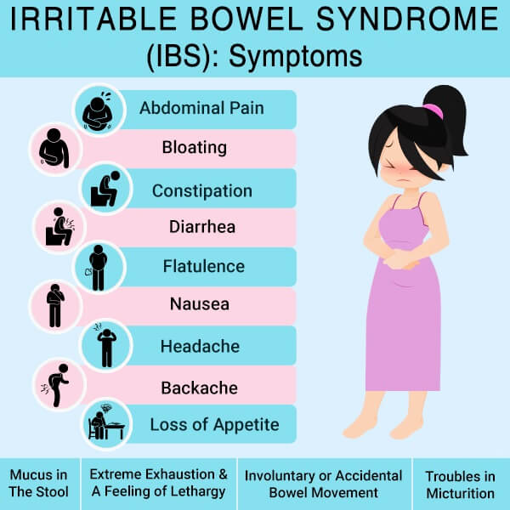
SYMPTOMS

Slide 4
OUR AIM
To evaluate IBS complains, nutrition and defecation habits among 4th and 5th year medical students of Bezmialem Vakif University
To show the relationship between the consumption of fibrous nutrients and high fructose corn syrup on IBS.

Slide 5
MATERIALS AND METHODS
Bezmialem Vakif University 4th and 5th year medical students
189 students
Online questionnaire
Stool characteristics, existency of abdominal bloating, type of dietary intake ( fast food, saturated fat, HFCS) and consumption of fibrous nutrients

Slide 6
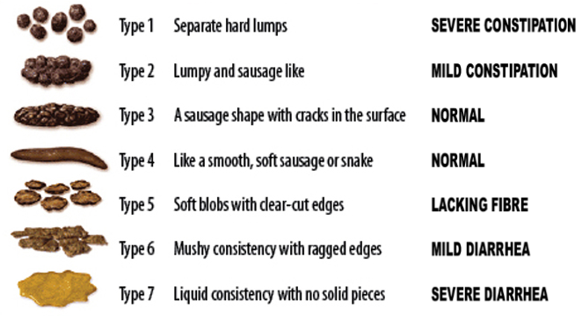
What is the shape of your stool ?
BRISTOL STOOL CHART

Slide 7
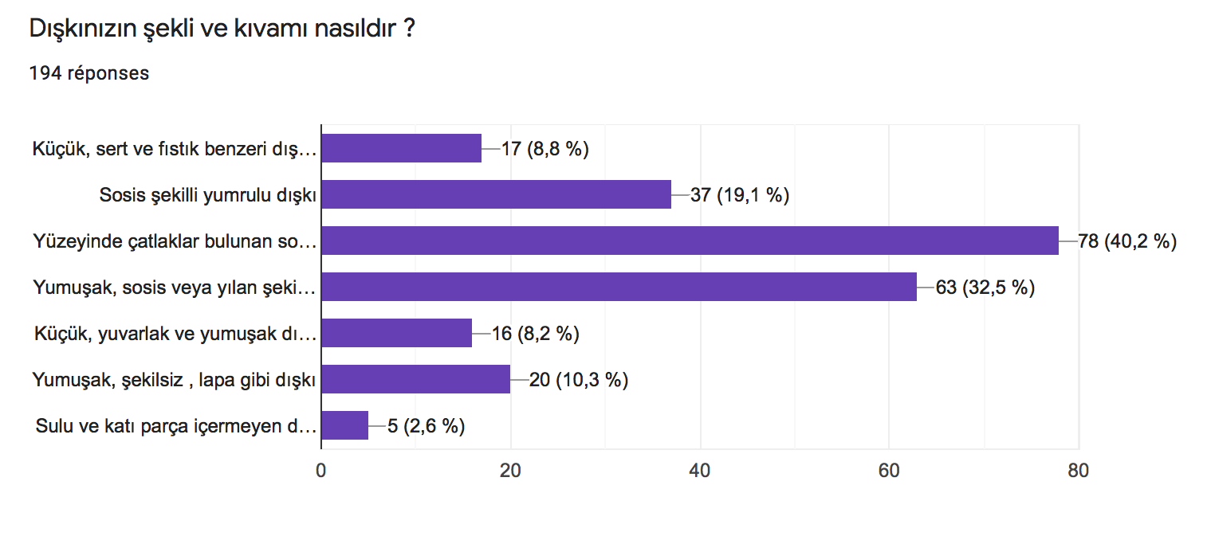

Slide 8
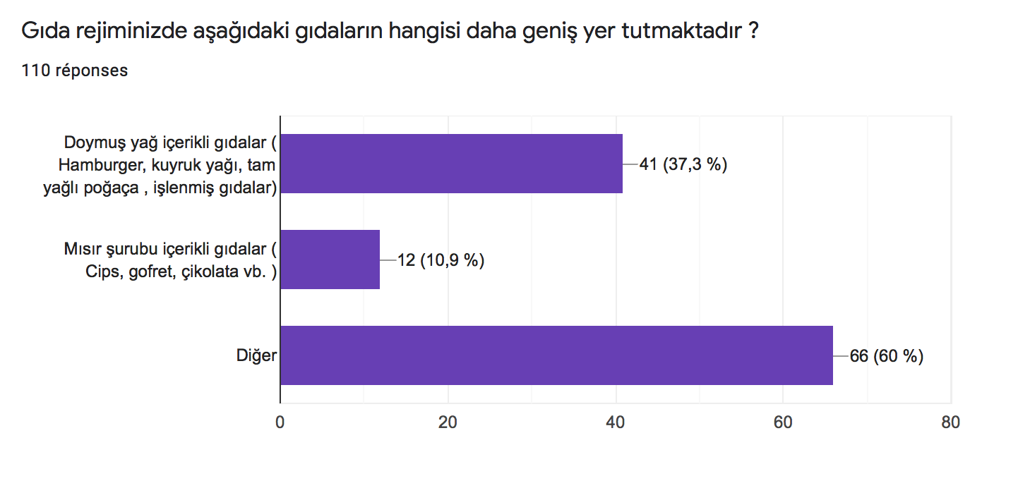

Slide 9
RESULTS
1-2 slices of whole wheat, bran and rye bread consumers per week (37,4 %) declared that they never have abdominal bloating
1-2 portion of bulgur consumers per week (42,2%) declared that they never have abdominal bloating
Students who have variable defecation habits(46,8%) stated relaxation after defecation and don’t have abdominal bloating
Students who were vegetable consumers 3-4 portions per week( %33,7) had never visited a gastroenterologist before .
Students (51,4%) who consume 1-2 slices of whole wheat, bran and rye bread weekly have never visited a gastroenterologist before.

Slide 10
CONCLUSION
Consumption of fibrous nutrients as vegetables and fiber-rich bread decreases appeal to gastroenterologist
Fiber-rich bread and bulgur consumption is useful to have less abdominal bloating.
Bulgur consumption can be sen seen with a variable defecation habit without any problem

Slide 11
REFERENCES
Talley NJ, Zinsmeister AR, Van Dyke C, Melton LJ 3rd. Epidemiology of colonic symptoms and the irritable bowel syndrome. Gastroenterology 1991; 101:927.
Drossman DA, Li Z, Andruzzi E, et al. U.S. householder survey of functional gastrointestinal disorders. Prevalence, sociodemography, and health impact. Dig Dis Sci 1993; 38:1569.
Jones R, Lydeard S. Irritable bowel syndrome in the general population. BMJ 1992; 304:87.
https://www.google.com.tr/amp/s/www.dunya.com/amp/saglik/spastik-kolon-olanlarin-ucte-birinin-sebebi-misir-surubu-olabilir-haberi-486661
https://www.elele.com.tr/saglik/guncel-saglik/beyaz-yakalilar-neden-diger-kisilere-gore-daha-cok-hastalik-yasiyor
Basaranoglu M, Celebi S, Ataseven H, Rahman S, Deveci SE, Acik Y. Prevalence and consultation behavior of self-reported rectal bleeding by face-to-face interview in an Asian community. Digestion. 2008;77(1):10-5. doi: 10.1159/000114827. Epub 2008 Jan 30. PMID: 18230973.

Slide 12
THANK YOU FOR YOUR ATTENTION

